Slide 1

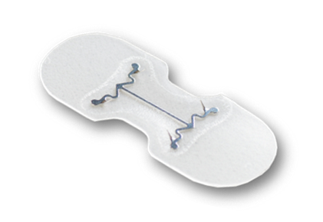
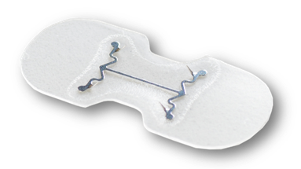
An Innovative Approach to Wound Closure
An Innovative Approach to Wound Closure
Facility Name
Date
Notes:
Introduction, territory responsibility, etc.
KitoTech Medical, LLC is an innovative company focused on wound care
Thank your audience for their time & participation

Slide 2

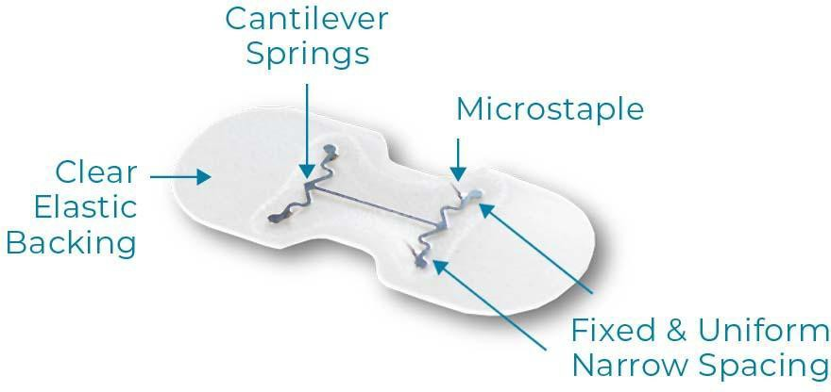

Patented Device Design
U.S. Patents No. 10,751,050 and No. 10,939,912
Notes:
Review product nomenclature
A patent-protected innovation

Slide 3
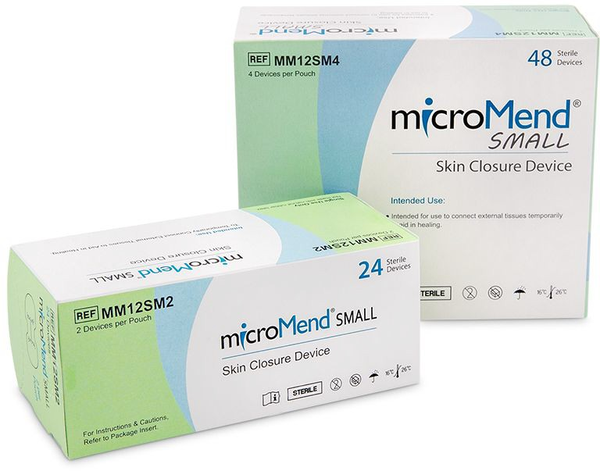
Popular Sizes
Medium
Small
Large
Notes:
Most popular sizes to address the average incision/laceration length of 4cm
Popular packaging (suture box sizing)

Slide 4
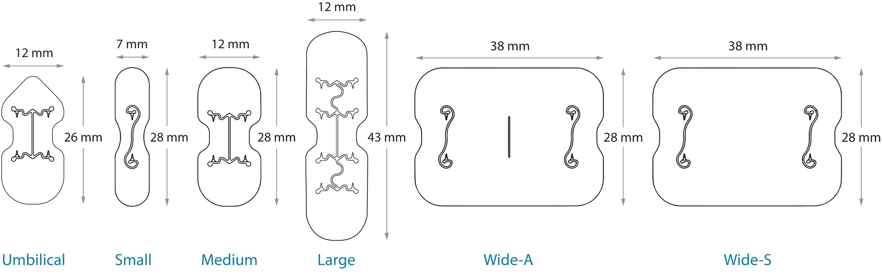
Product Line
Notes:
Total product line sizes to address laparoscopic port closures and skin incisions/tears up to 50cm (approx. 19 inches)

Slide 5
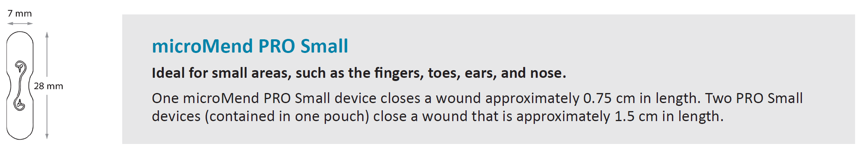
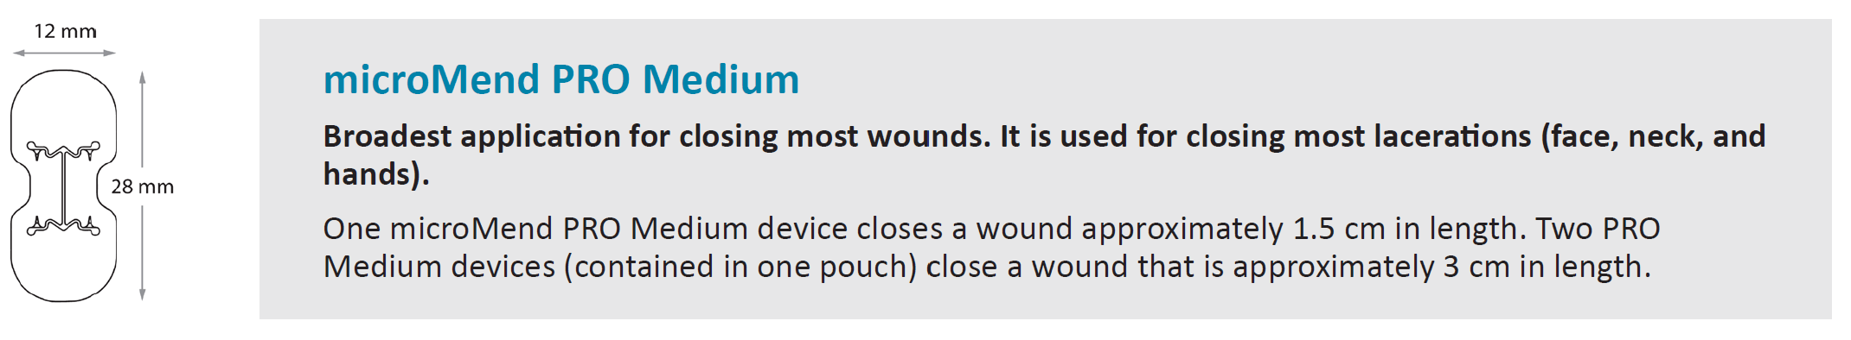
Suggested Usage

Slide 6
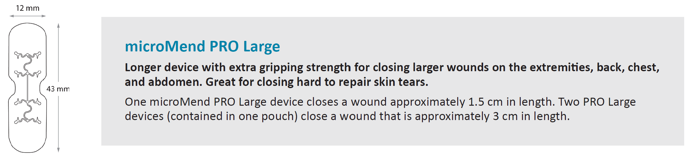
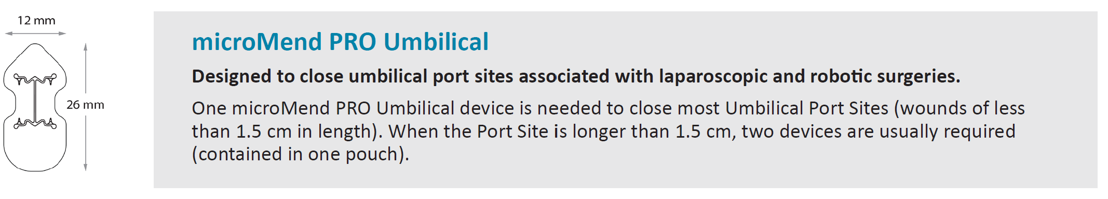
Suggested Usage

Slide 7
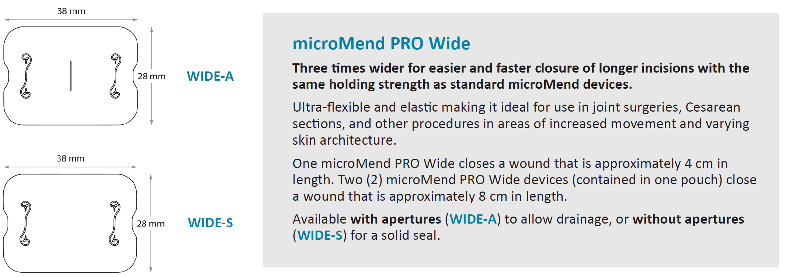
Suggested Usage

Slide 8
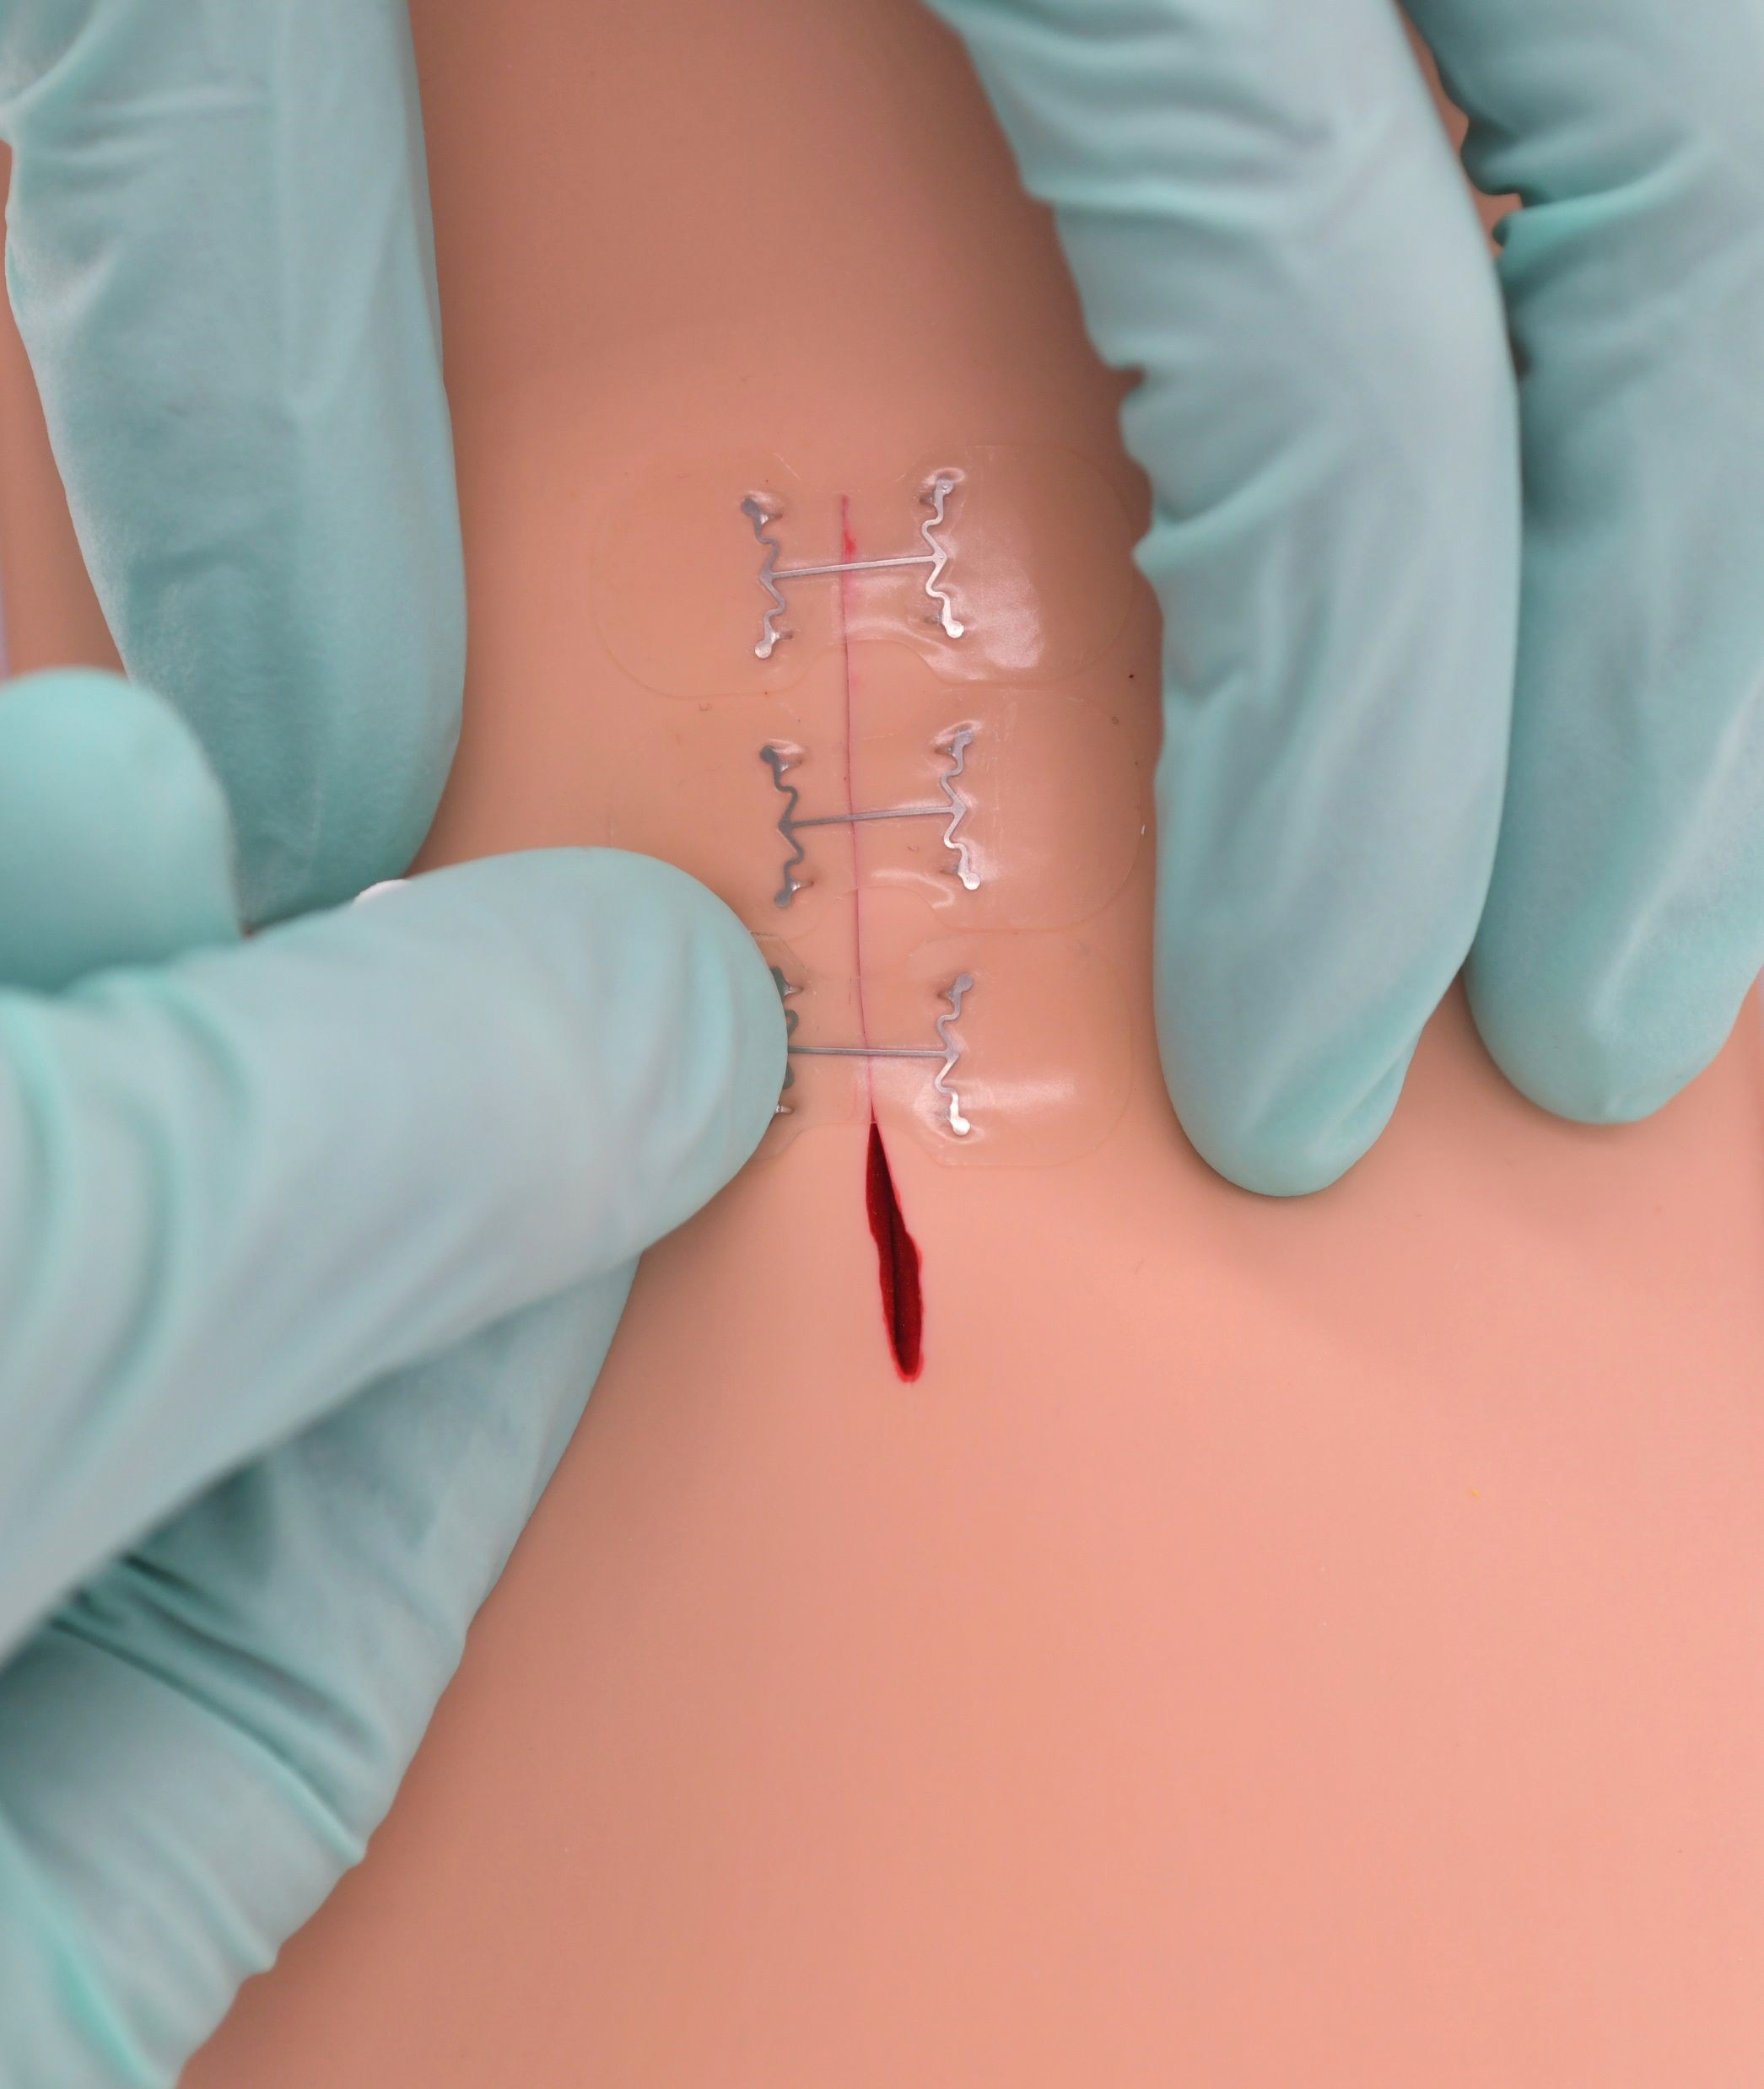
Key Attributes
Applies in seconds saving valuable time
Holding strength of suture
Embedded Microstaples provide more secure closure than adhesive alone
Quickly close with little to no scarring

Slide 9
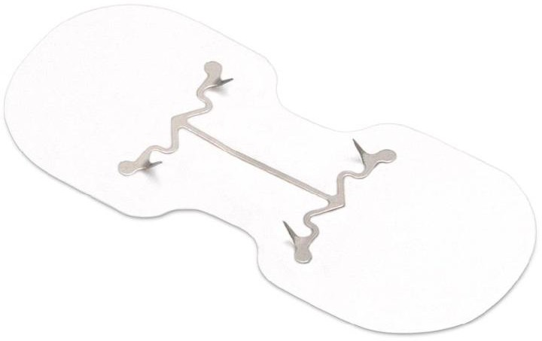
Key Attributes
Supports Efficient and Fast Patient Throughput
Remove at Home - No Return Clinic Visit Required
Avoids possible Needle Sticks
Can Be Applied with Minimal Staff Training
Notes:
Ask audience what they think. Do the attributes resonate with the audience?

Slide 10
Wound “Behavior”
Up to 1 cm* Gap
Incisional Forces
* microMend® PRO Skin Closure Device Indication
Notes:
Review product nomenclature
A patent-protected innovation

Slide 11
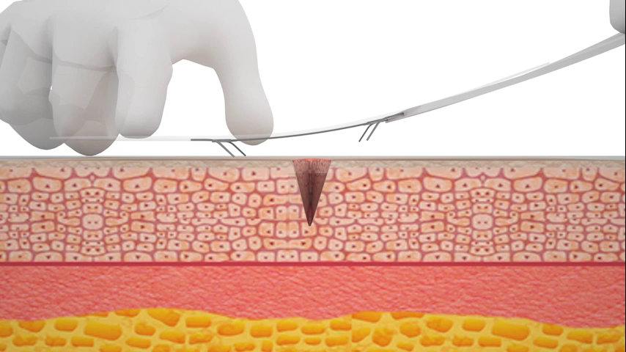
Wound “Behavior”
Notes:
Review product nomenclature
A patent-protected innovation

Slide 12
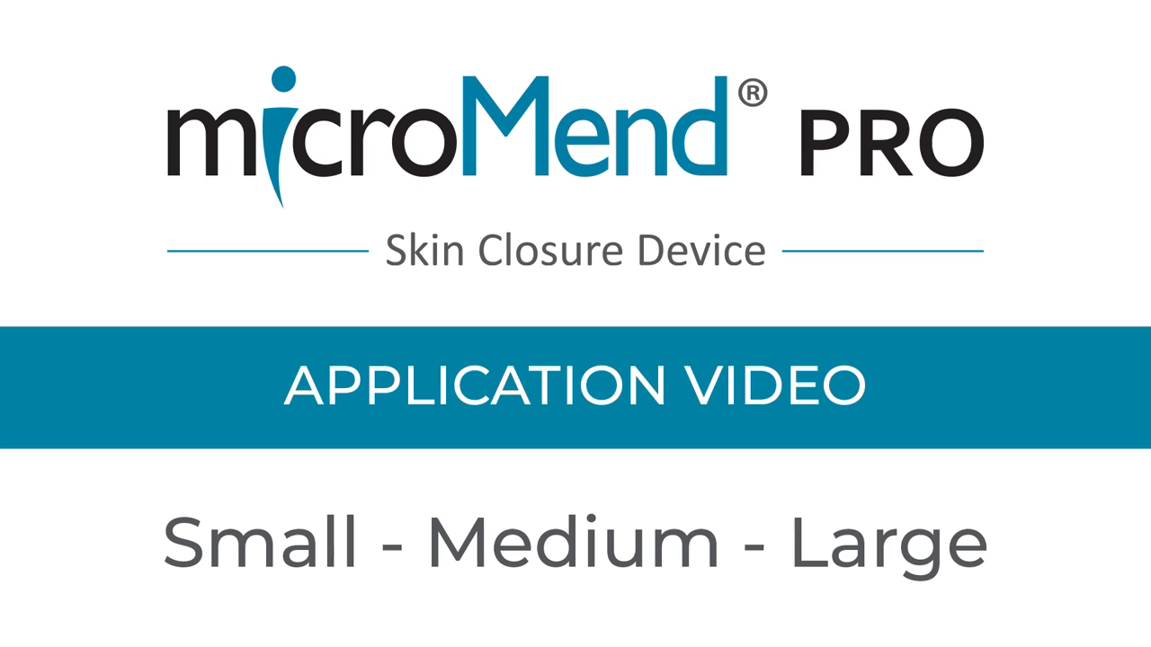

Slide 13
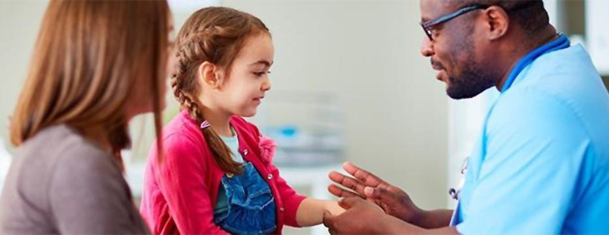
Ideal for Pediatric Patients
Painless application and removal (at home)
Significantly shortens treatment time
Notes:
Review specific benefits for this demographic

Slide 14
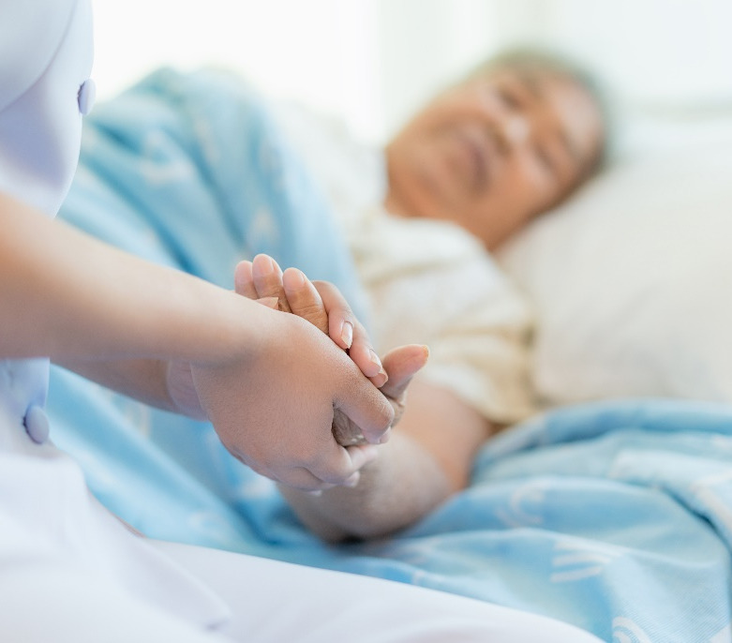
Ideal for Geriatric Patients
Microstaples reduce skin damage
Gentle application allows closure without tearing skin (unlike sutures)
Provides safe and effective closure of skin tears
Reimbursable procedure (as opposed to covering with dressing)
Notes:
Review specific benefits for this demographic

Slide 15
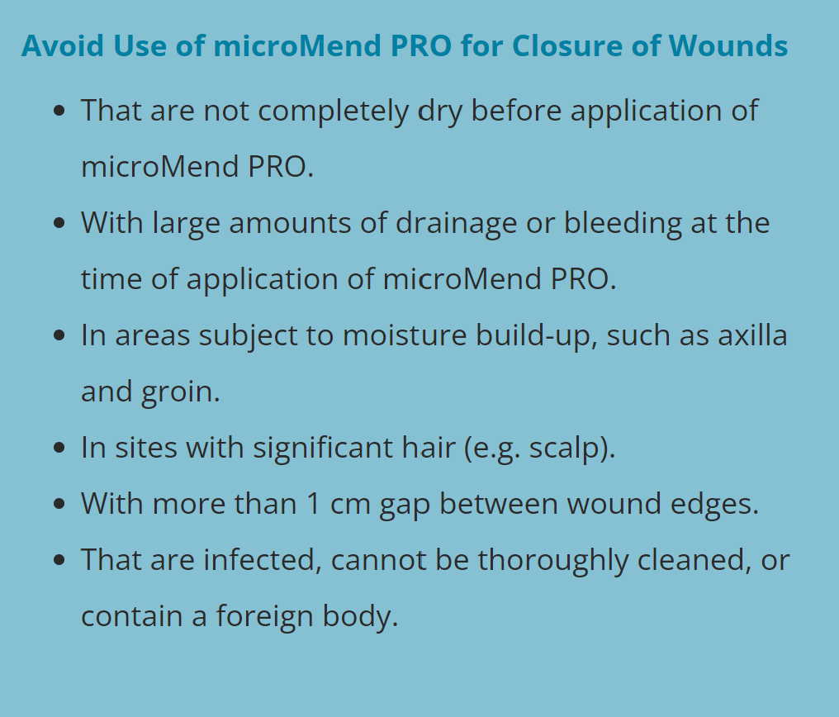
Contraindications
Notes:
Review specific benefits for this demographic

Slide 16


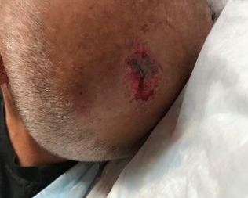
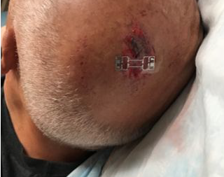
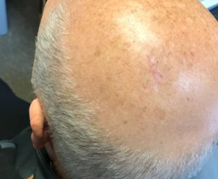
CLINICAL STUDY – Brown University
Head
Before microMend
microMend Applied
3 Months Post-Op
Notes:
Review before/after photos

Slide 17
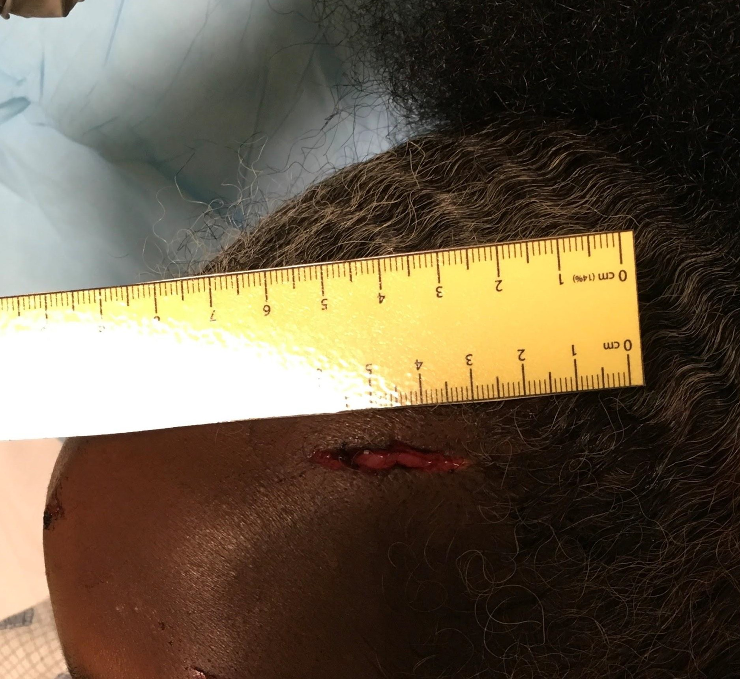
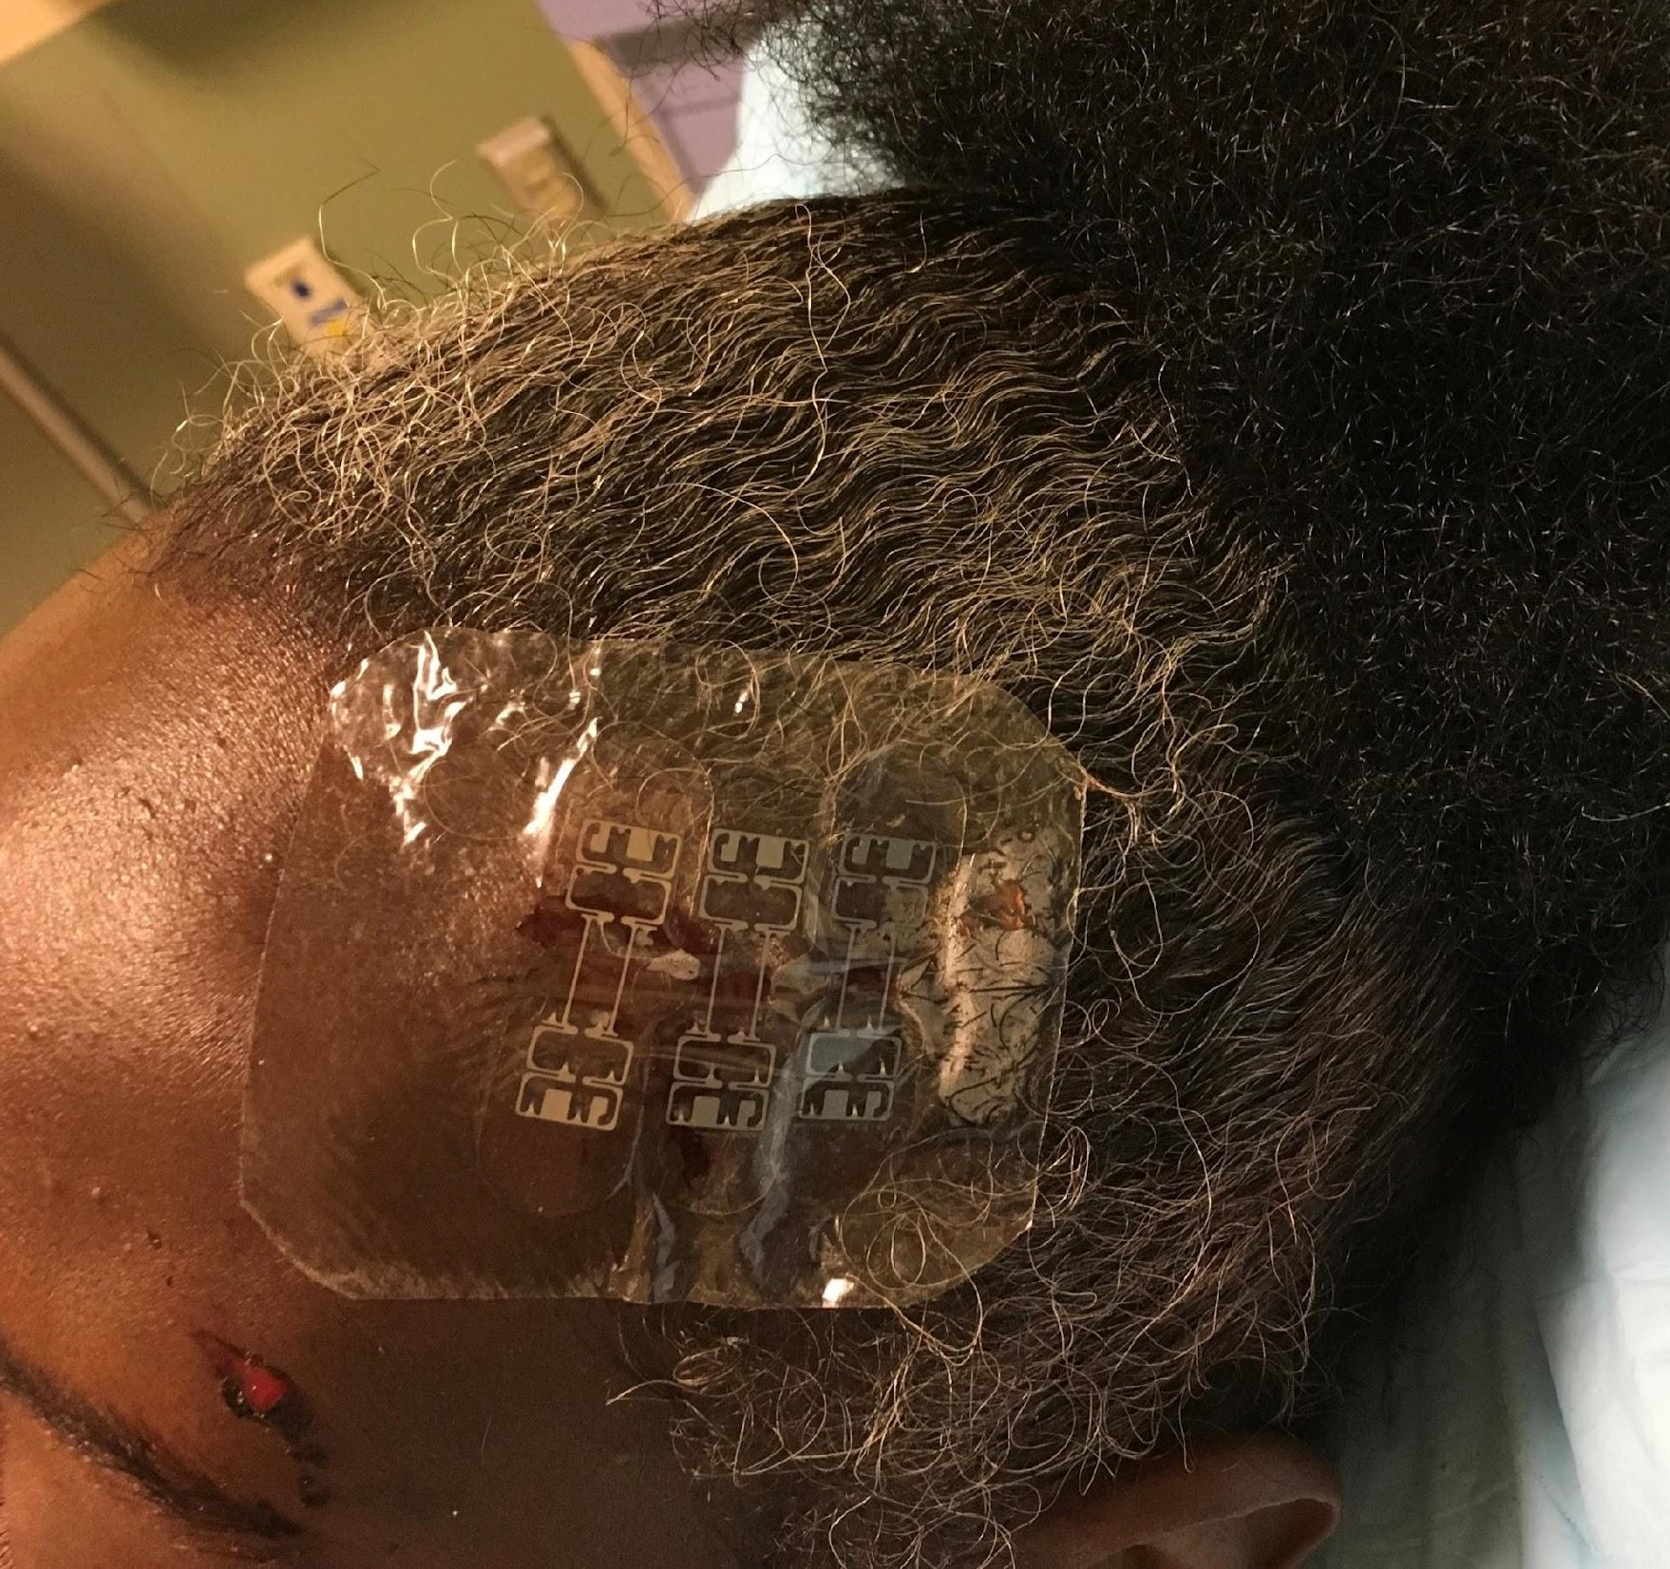
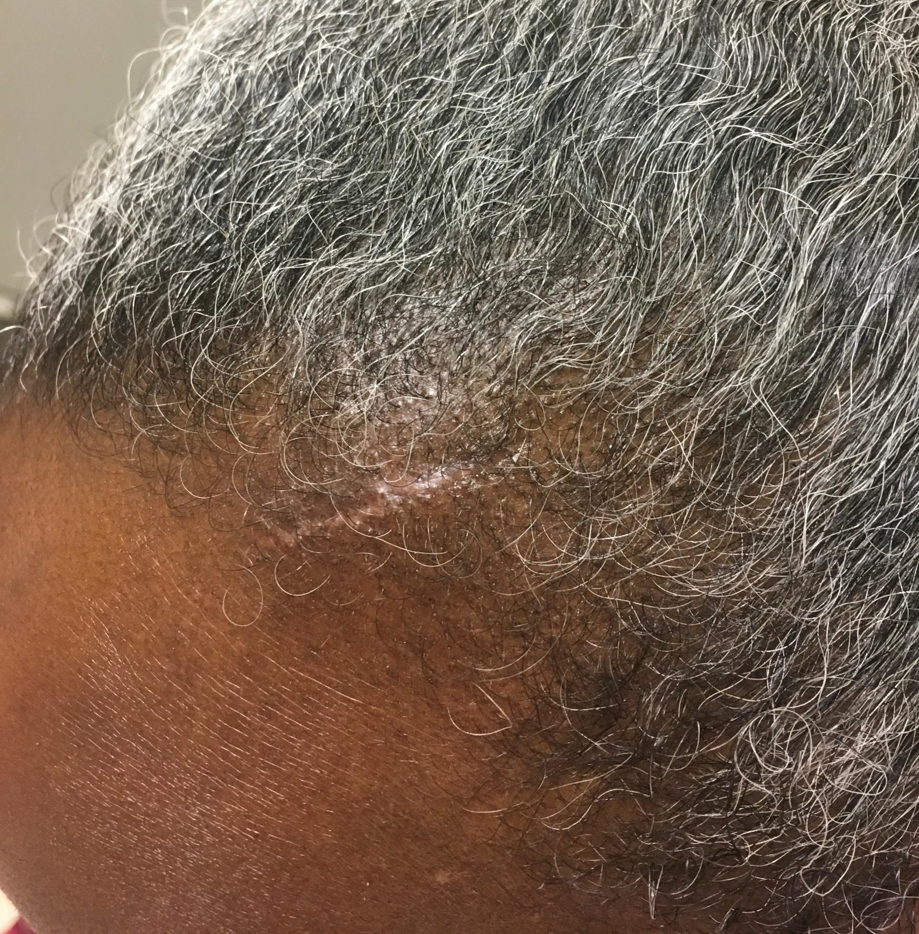
CLINICAL STUDY – Brown University
Forehead
Before microMend
microMend Applied
3 Months Post-Op
Notes:
Review before/after photos

Slide 18


Clinically Proven Results
Physicians and Patients Agree that microMend PRO is Superior to Sutures.
Multiple clinical and case studies have shown Outstanding Clinical Results using microMend PRO to close wounds in a broad range of clinical specialties.
Notes:
Offer up clinicals…print up a few copies for audience distribution

Slide 19

QUESTIONS?
Brad DuPree
Sales Director - USA
bdupree@kitotechmedical.com
Mobile: (913) 544-4974
www.micromendskinclosure.com
Notes:
Address questions
Ask audience if you missed anything…what additional content do they need or require?
Close – next steps

